Slide 1
Main 함수 수정
for all s of sources:
if (error sum of all sources
>= beta*entropy[s] + error sum of other sources):
append pair of (beta*entropy[s]+error[s] : s) into dict
if list is not empty:
cost = list.value(max or min(list.key))
doObserve(cost)
else:
do nothing
endif

Slide 2
Max value | Ea<Ha | Ea>=Ha
Eb<Hb | ? | Ea+Hb
Eb>=Hb | Eb+Ha | Ea+Eb
Min value | Ea<Ha | Ea>=Ha
Eb<Hb | Ea+Eb | Eb+Ha
Eb>=Hb | Ea+Hb | ?

Slide 3

비교 source 수정
Source 0 (extreme case) = $\left[\begin{matrix}0.4 & 0.6 \\ 0.6 & 0.4\end{matrix}\right]$
Source 1 = $\left[\begin{matrix}p & 1−p \\ 1−p & p\end{matrix}\right]$

Slide 4
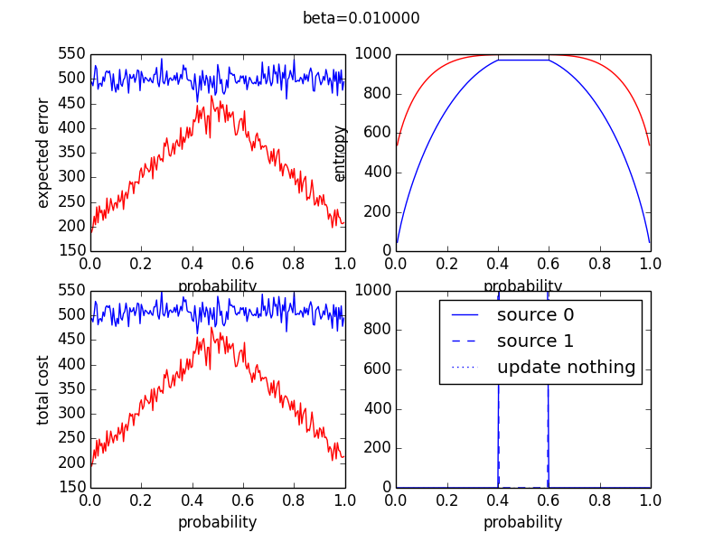
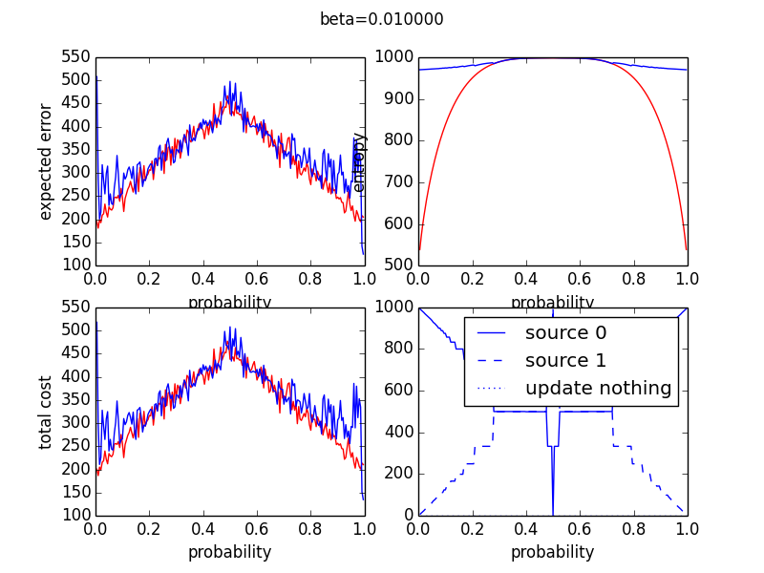
Max vs Min value
Round robin cost minimization
Beta =0.01

Slide 5
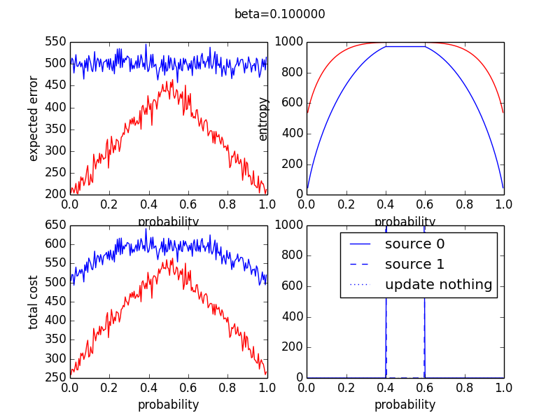
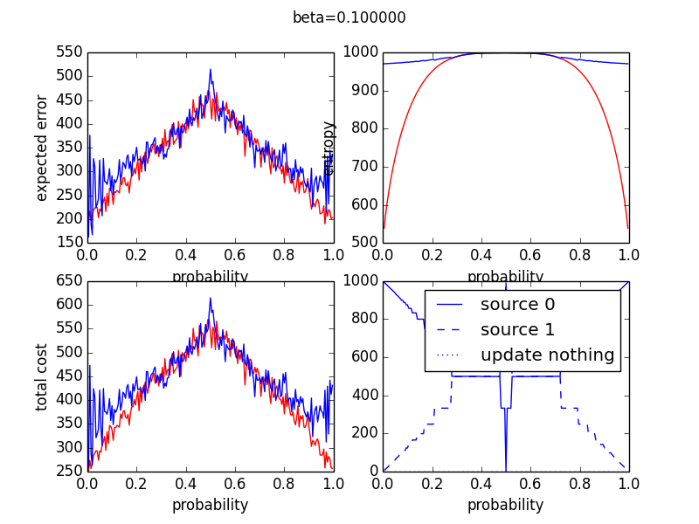
Max vs Min value
Round robin cost minimization
Beta =0.1

Slide 6
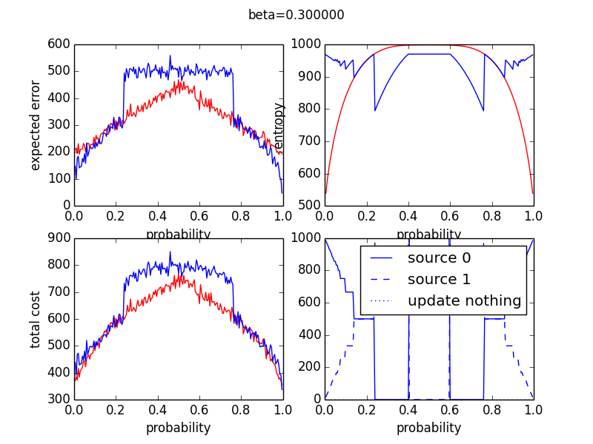
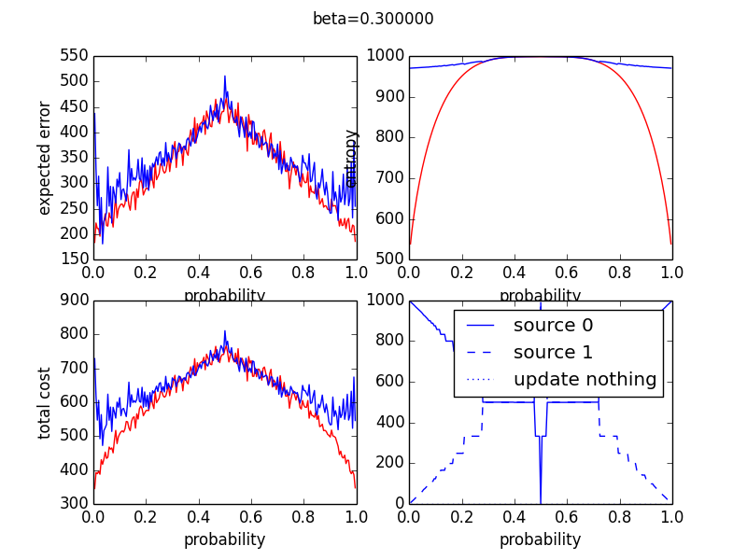
Max vs Min value
Round robin cost minimization
Beta =0.3

Slide 7
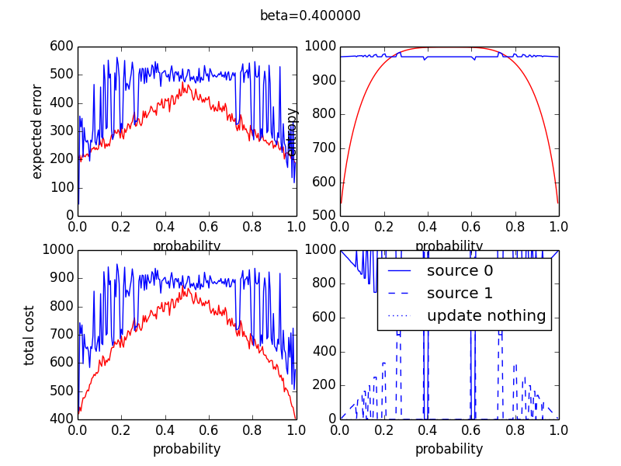
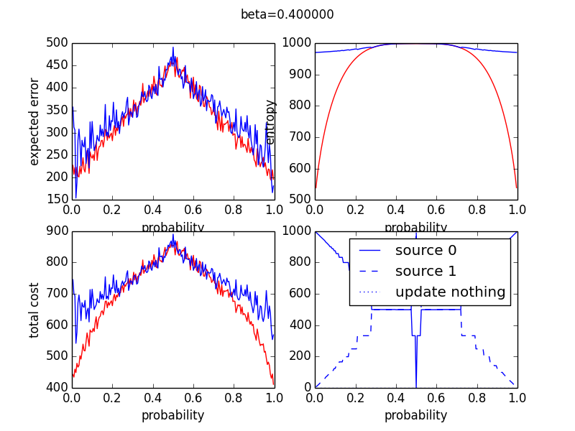
Max vs Min value
Round robin cost minimization
Beta =0.4

Slide 8
자주 업데이트 하는 것이 최적인가?
여러 개의 (3개 이상)의 source를 시뮬레이션 했을 때는 어떤 결과가 나올 것인가?

